Slide 1
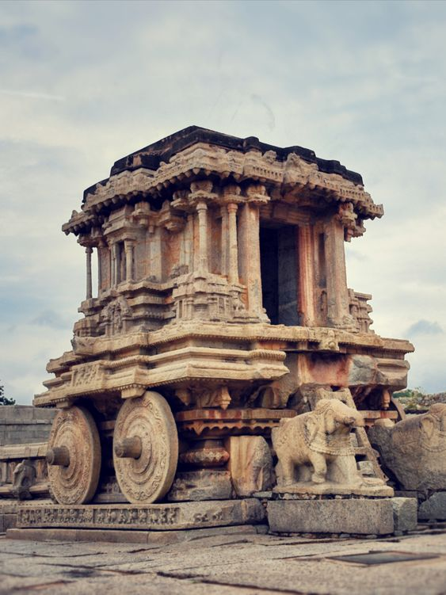

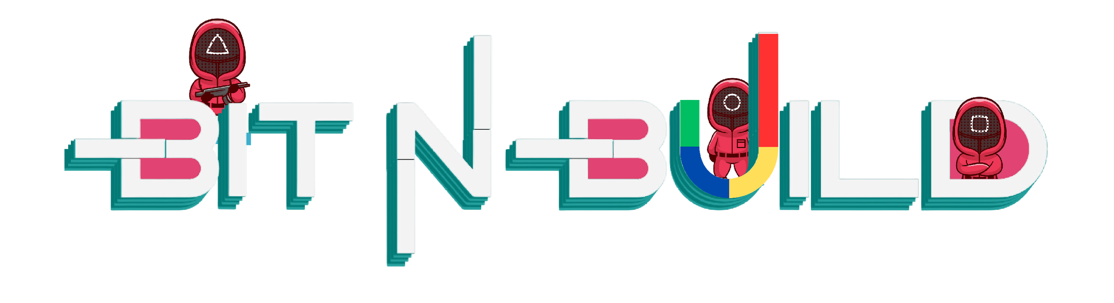
State Level - Karnataka
28th and 29th September 2024

Slide 2
Team Name: Poseidon
Team Members: Karthik A S
Gowtham D V
Dakshesh S
Adarsh S Naik

Slide 3
Name of the Project: The Eco Wardrobe: Style that Cares

Slide 4
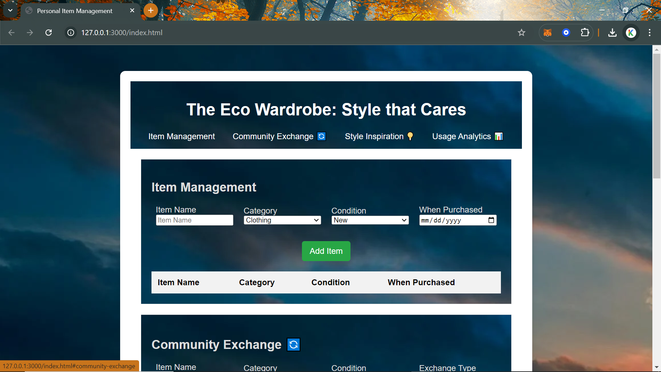
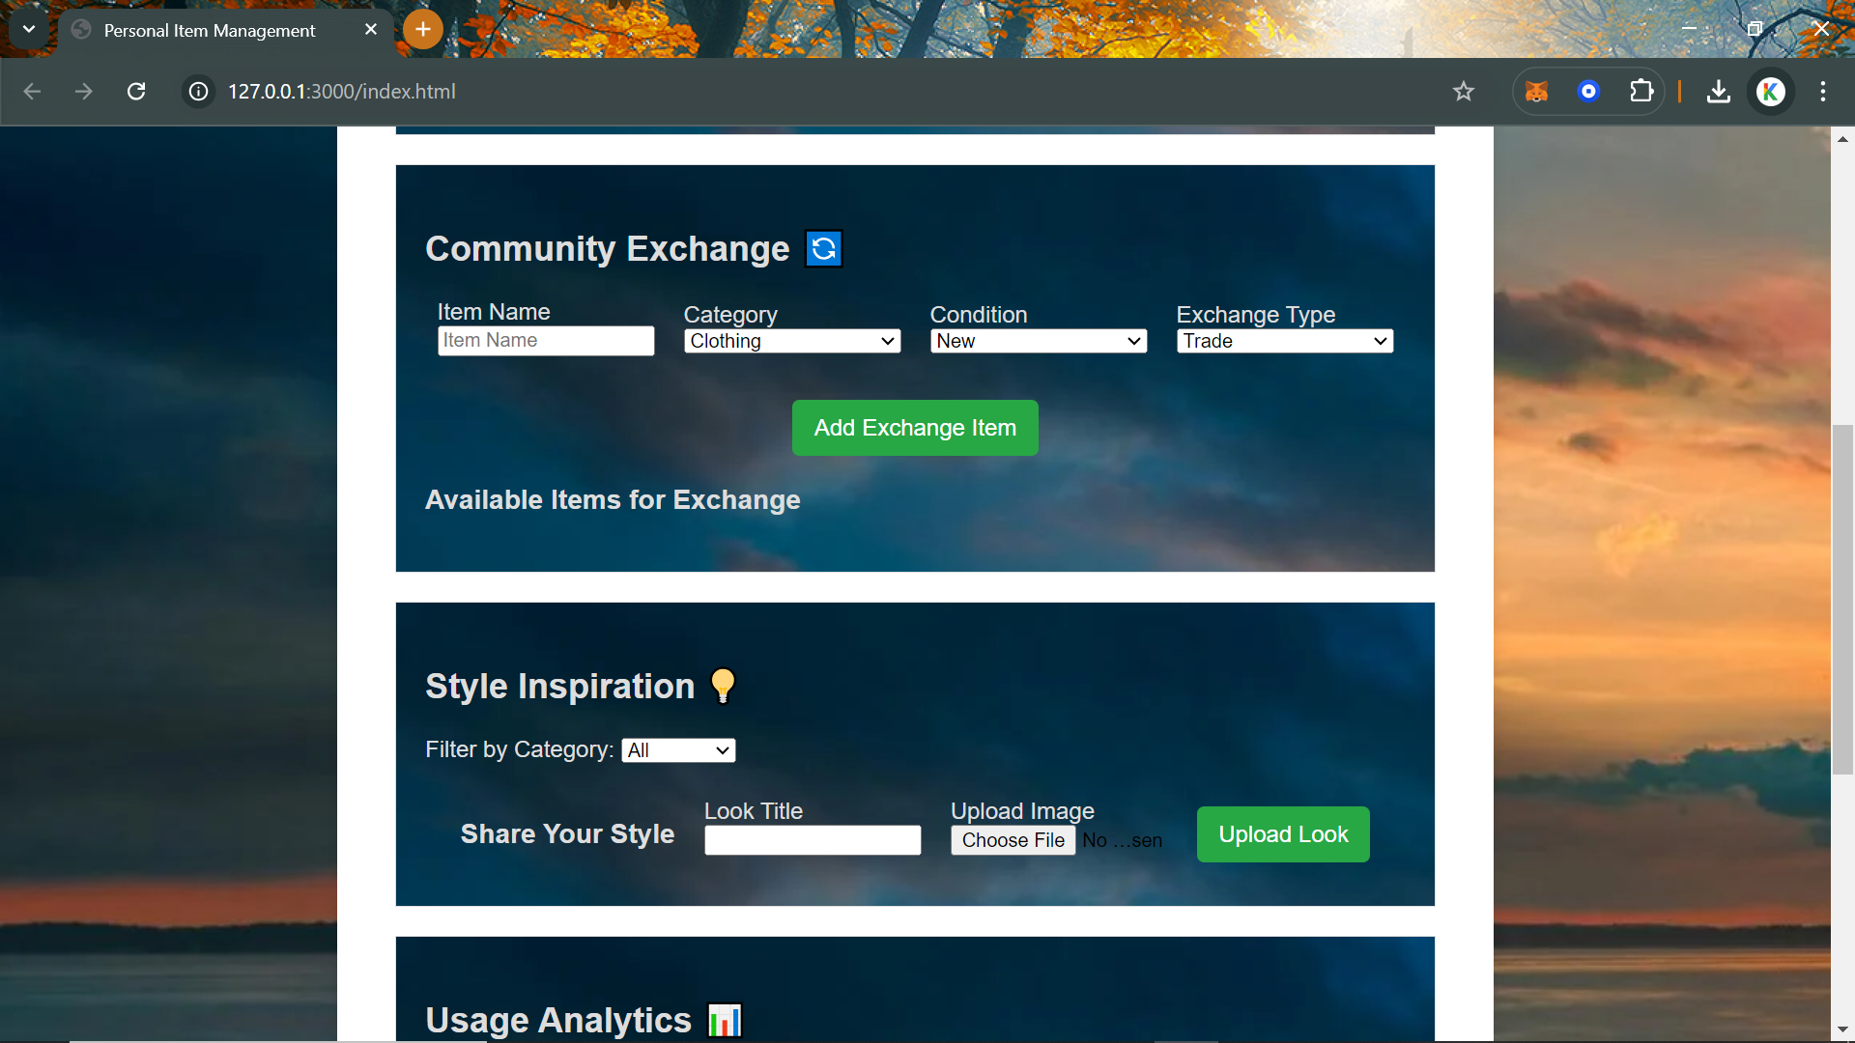
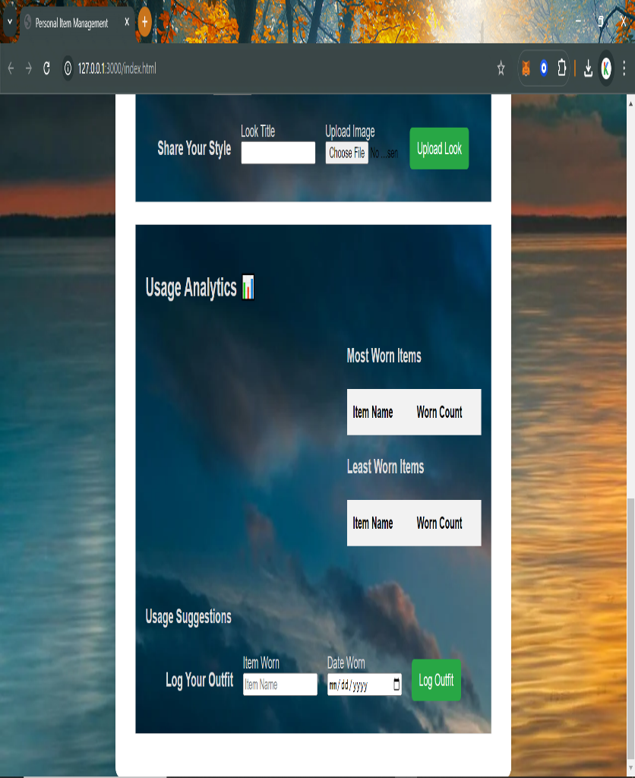
Snapshot of the prototype

Slide 5
GitHub Link: https://github.com/karbhat74/Bit-n-Build.git
Hosted Link: https://karbhat74.github.io/Bit-n-Build/
Video Link: https://go.screenpal.com/watch/cZQur8VSHdM

